Slide 1
Data Acquisition for Researchers
Christopher Lute
13 June 2024

Slide 2
Areas of expertise
Data acquisition
Controls
Industrial communications
Electrical wiring and power

Slide 3
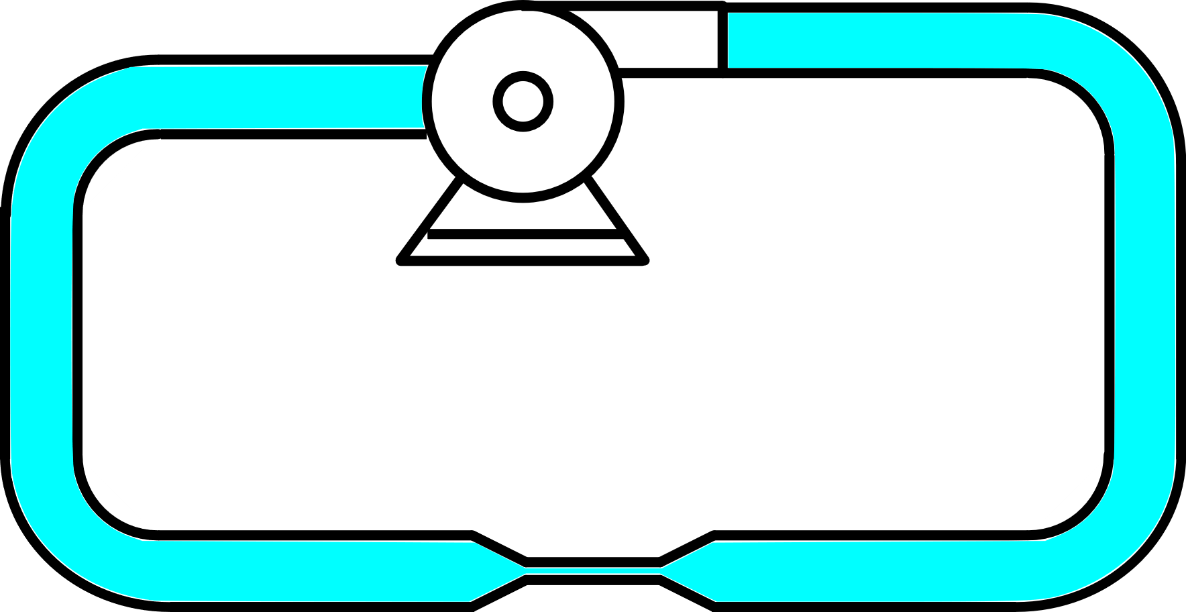

Hydraulic analogy
Pressure : Voltage
Flow rate : Current
Restriction : Resistance
Voltage (V) [Volts, V] = Current (I) [Amps, A] × Resistance (R) [Ohms, Ω]
Notes:
Electrical systems can be confusing – a common analogy is to compare electrical circuits to hydraulic systems. Voltage behaves kind of like pressure and current is like the flow rate of the water. Resistors are like a restriction in the pipe; voltage will drop across a resistor just like pressure will drop across a restriction

Slide 4
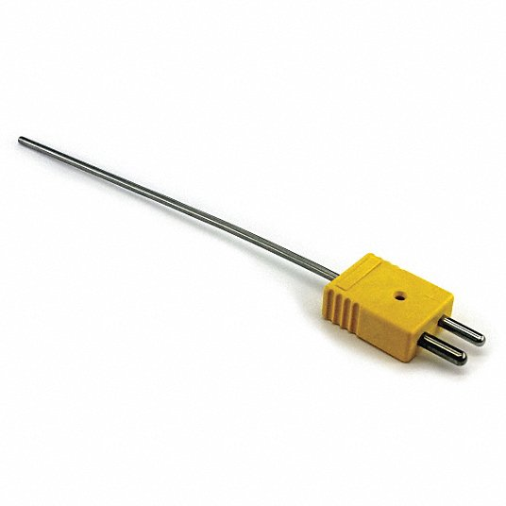
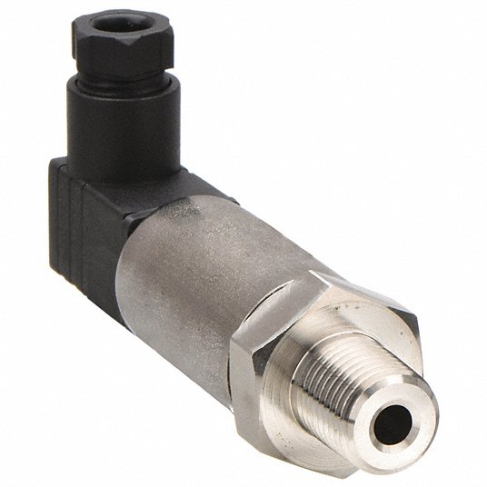
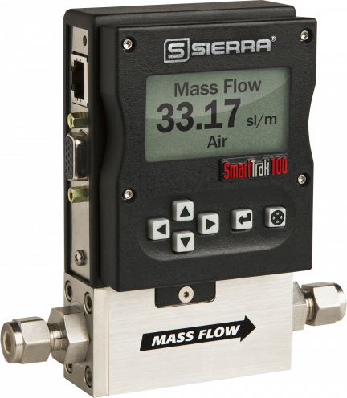
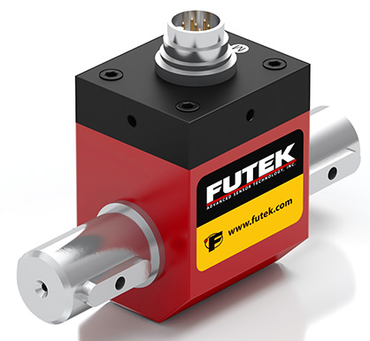
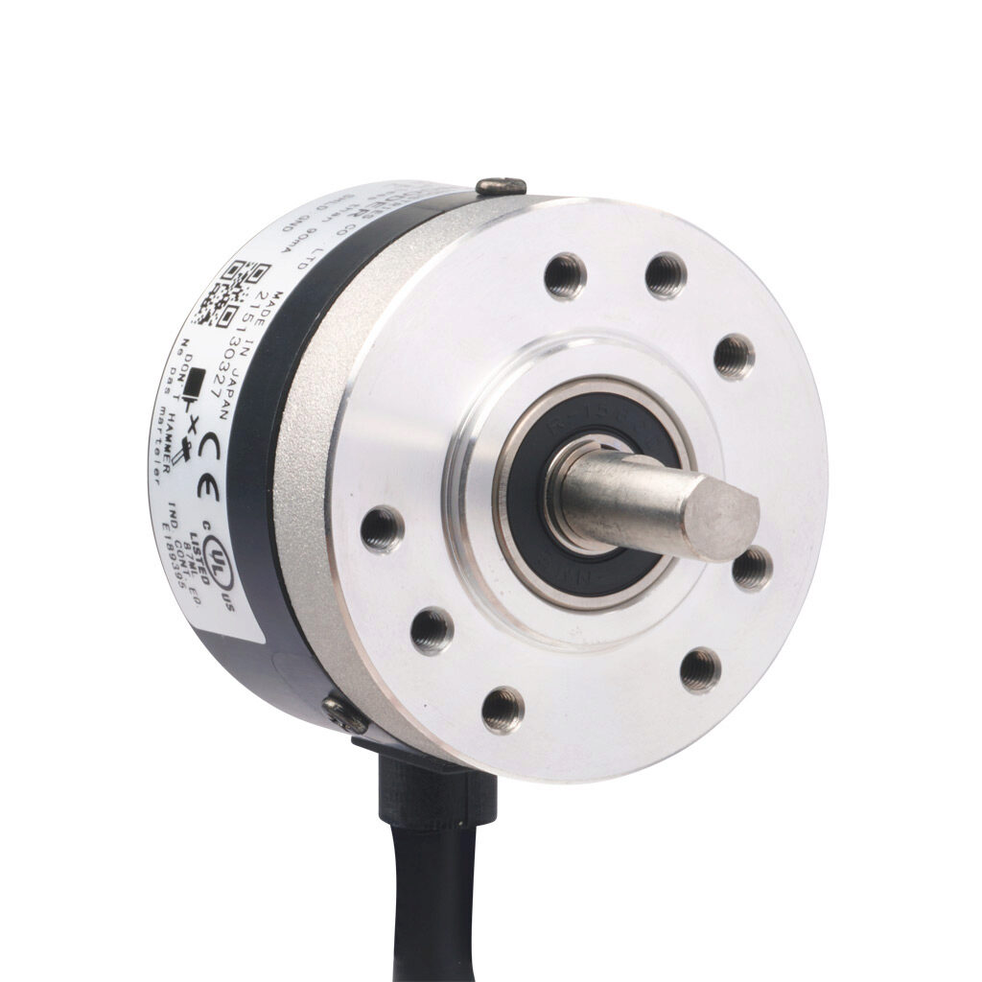
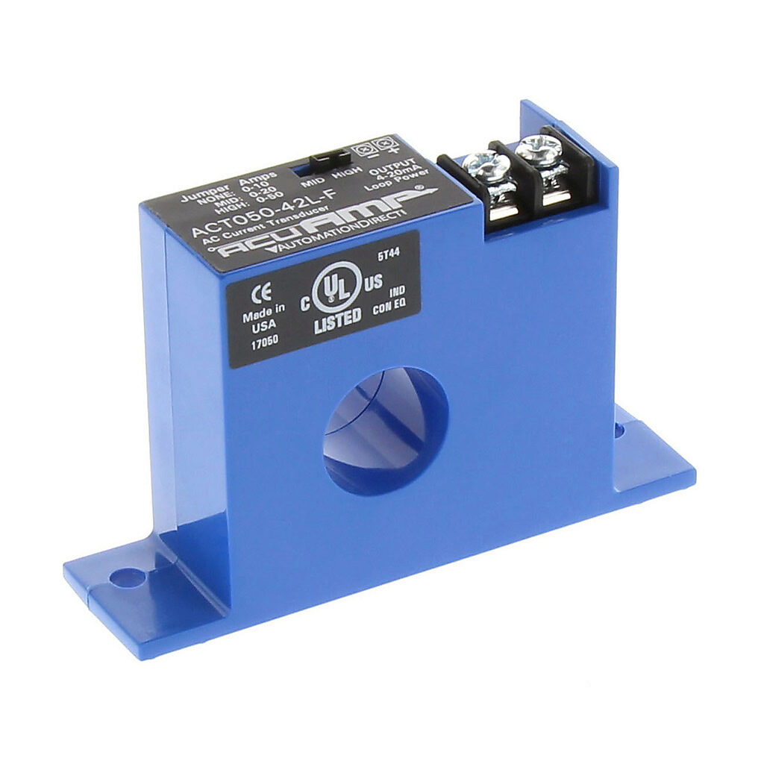
Common sensor types
Thermocouples
Pressure transducer
Flow meter
Torque sensor
Rotary encoder
Current transducers

Slide 5
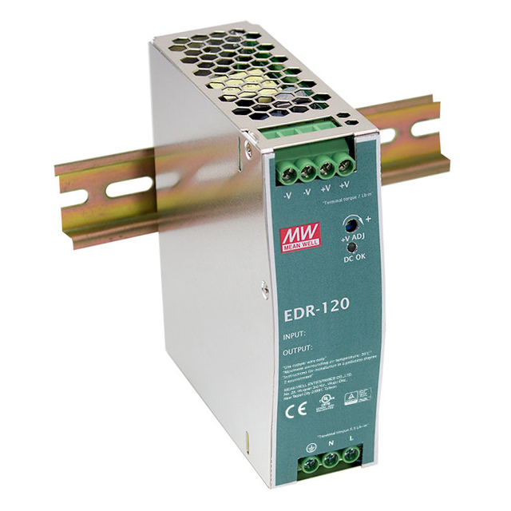
Instrument power
Most sensors and measurement instruments require power
Common voltages are 24V, +/-12V, 5V
Instrument power supplies should be isolated from earth ground
Most power supplies use high-frequency switching components that generate electromagnetic interference (EMI)

Slide 6
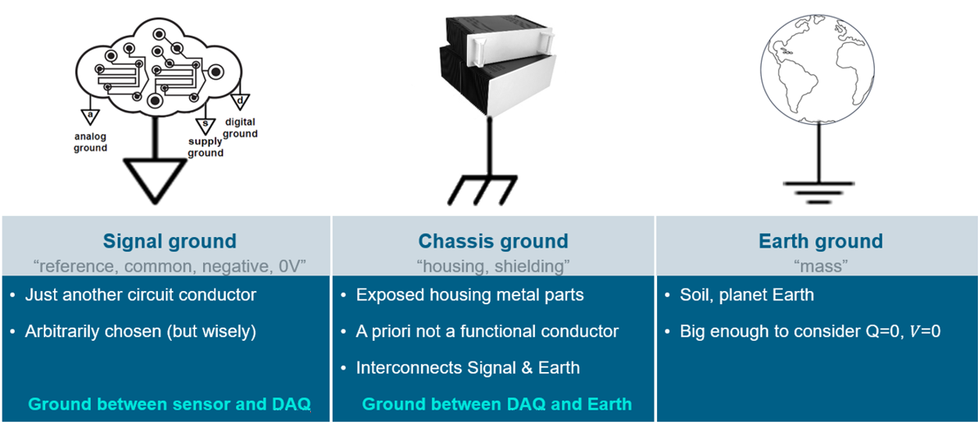
Grounding
Notes:
Any time you are making measurements, you need to know where your zero reference is. This is known as signal ground and is often the negative terminal of your instrument power supply. Signal ground is important for measurements, while chassis and earth ground are primarily for safety. Because noise can exist on chassis or earth ground signal ground is usually isolated from these.

Slide 7
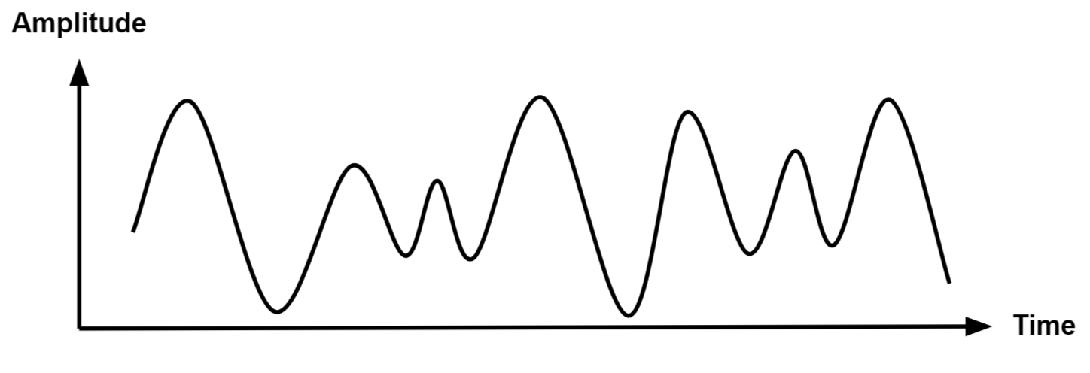
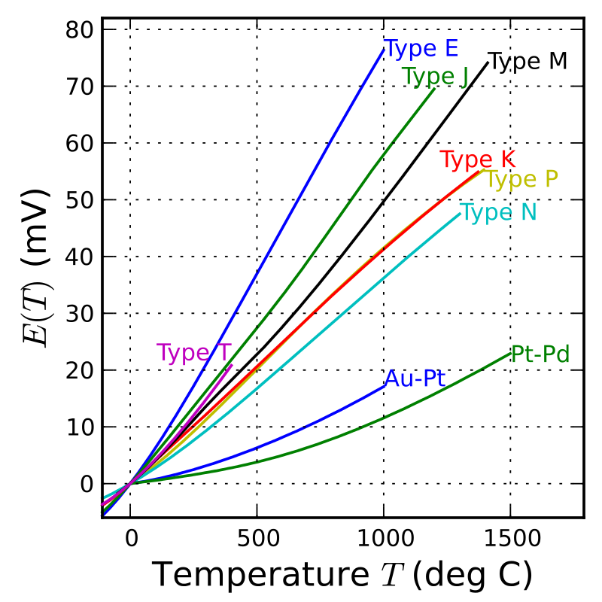
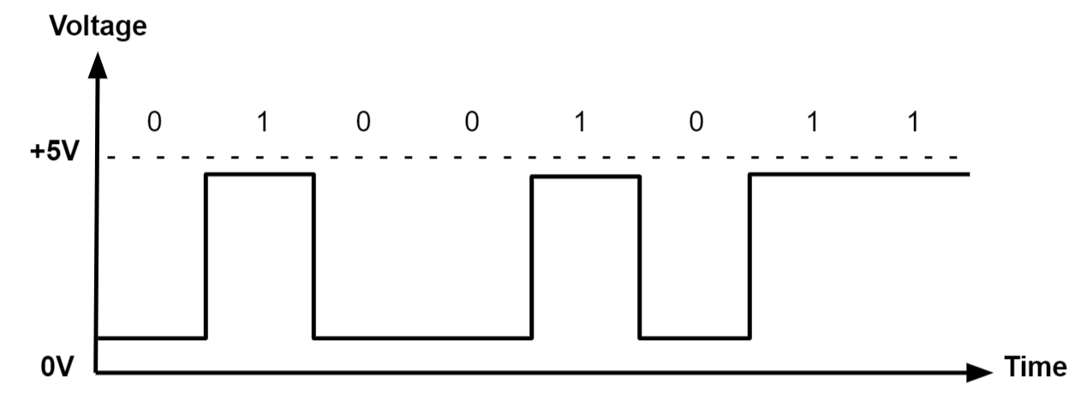
Signal types
Analog
Thermocouple
Digital

Slide 8
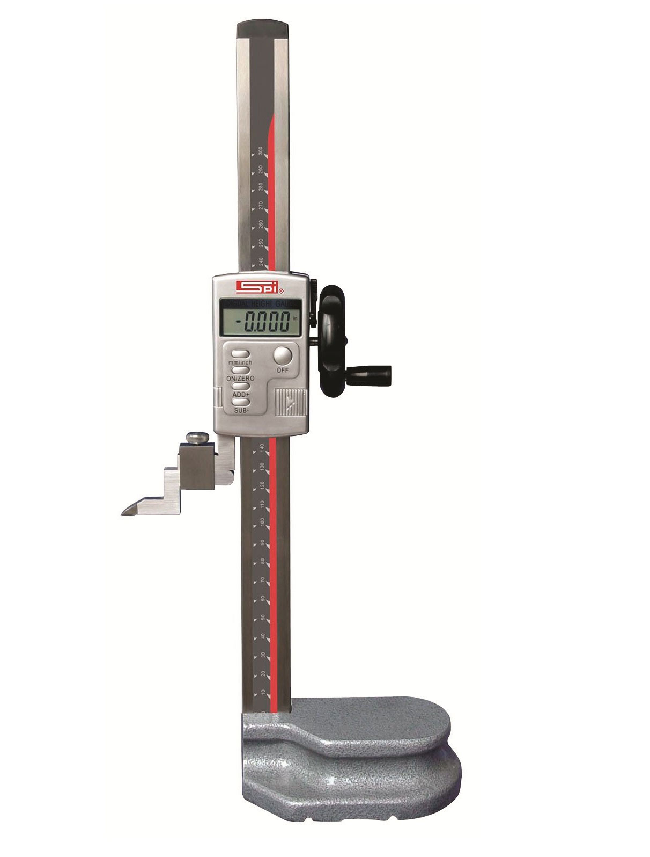
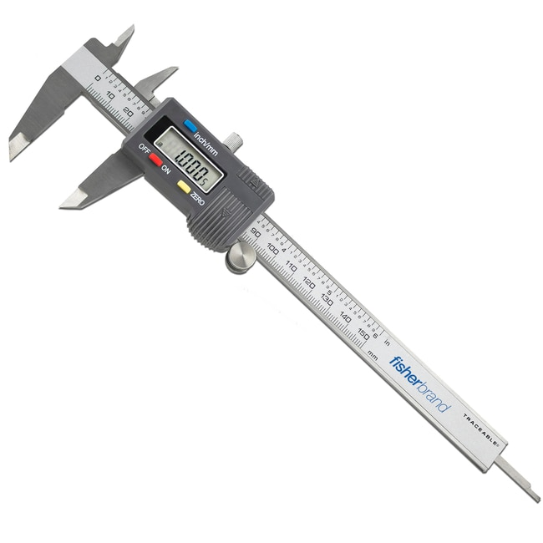
Single-ended vs. differential
Single ended
All measurements referenced to a common reference COM or GND
Differential
Measures the potential difference between two points

Slide 9
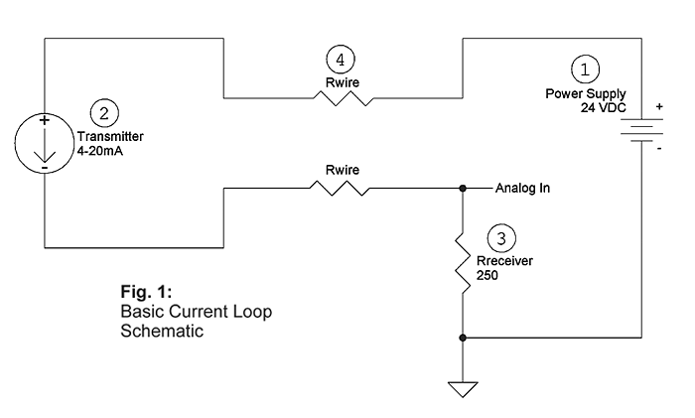
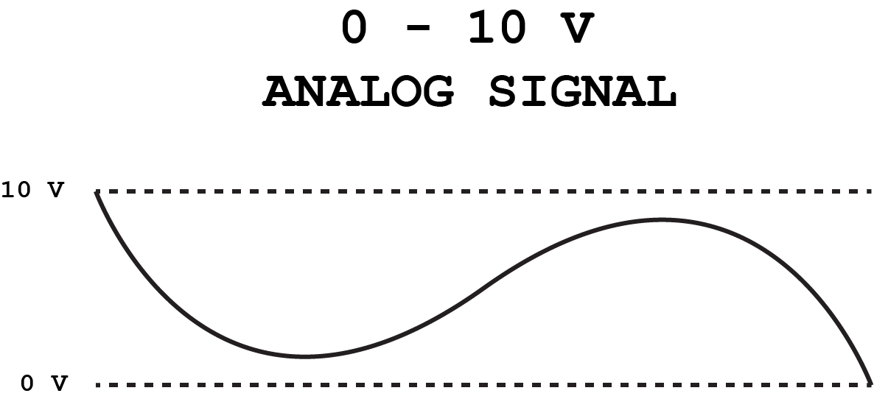
Types of analog signals
0-5 V or 0-10 V
4-20 mA
Easier to measure
Signal wires have voltage drop
More vulnerable to noise
No way to determine an instrument with a reading of zero and a problem
Harder to measure
Typically requires resistor
Current is constant
Less vulnerable to noise
Lower resolution
Ohm’s Law V=IR
250 Ω → 1-5 V
500 Ω → 2-10 V

Slide 10
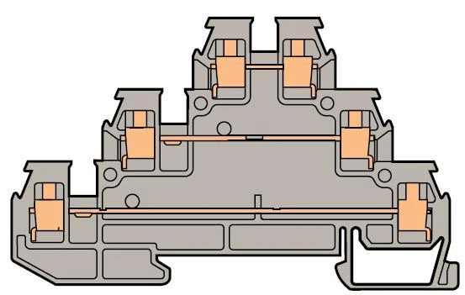
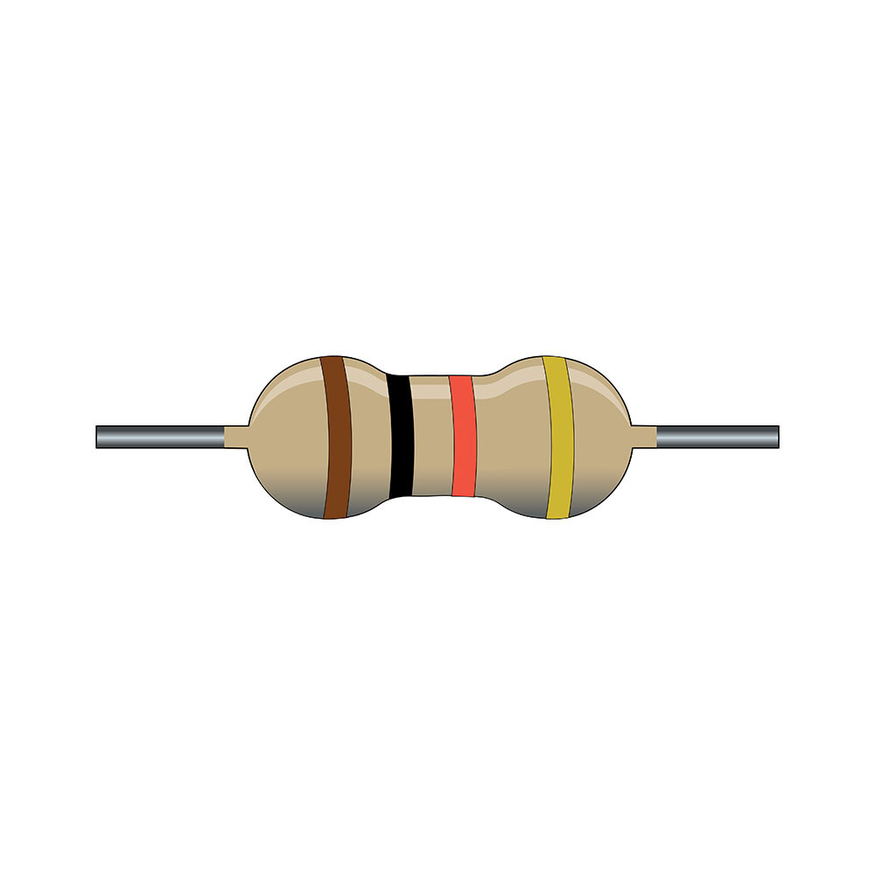
Loop powered sensor
DAQ
1-5 V
+
V
-
4-20 mA
Power supply
V (-)
Instrument
V (+)

Slide 11
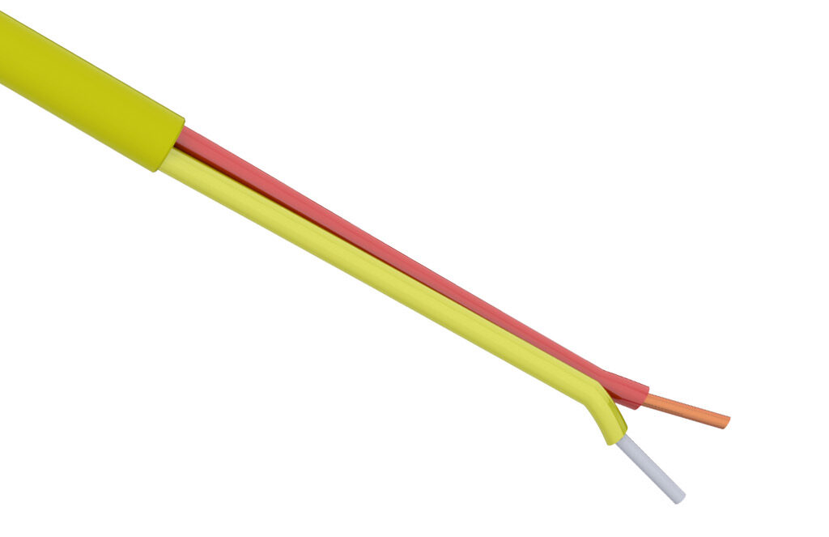
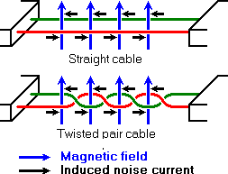
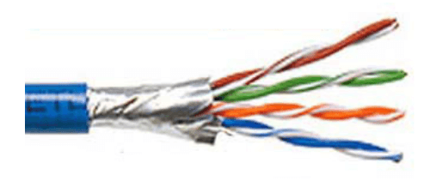
Wire types
Thermocouple (TC) wire
Used to connect to thermocouples
Two conductors: yellow (+), red (-)
Twisted pair
Twisting conductors together cancels noise
Shielded twisted pair
An outer metal foil or braid absorbs EMI before it can reach the signal conductors

Slide 12
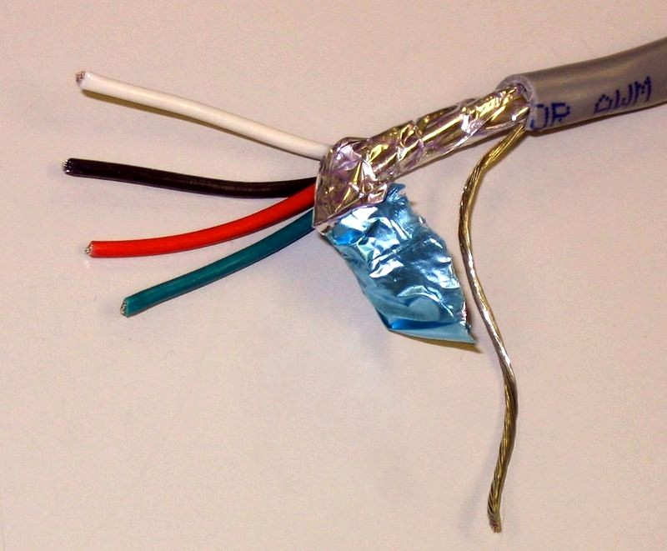
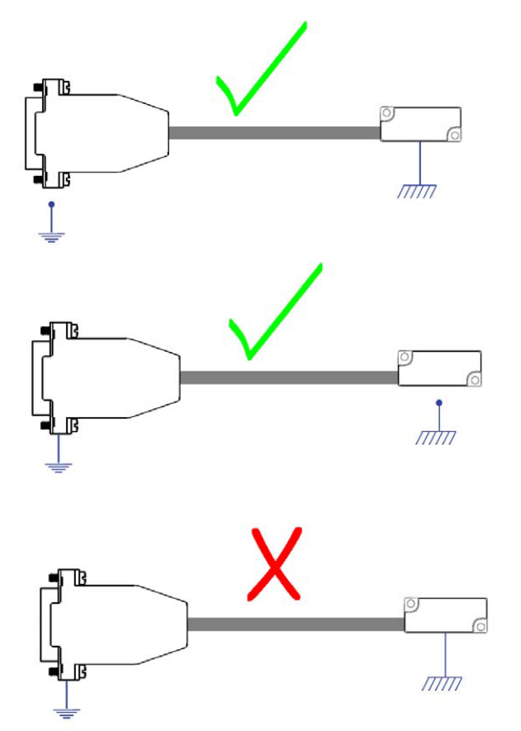
Shielded cable
Drain wire
A bare wire in continuous contact with the shield
The drain wire should be connected to earth or chassis ground at one and only one end

Slide 13
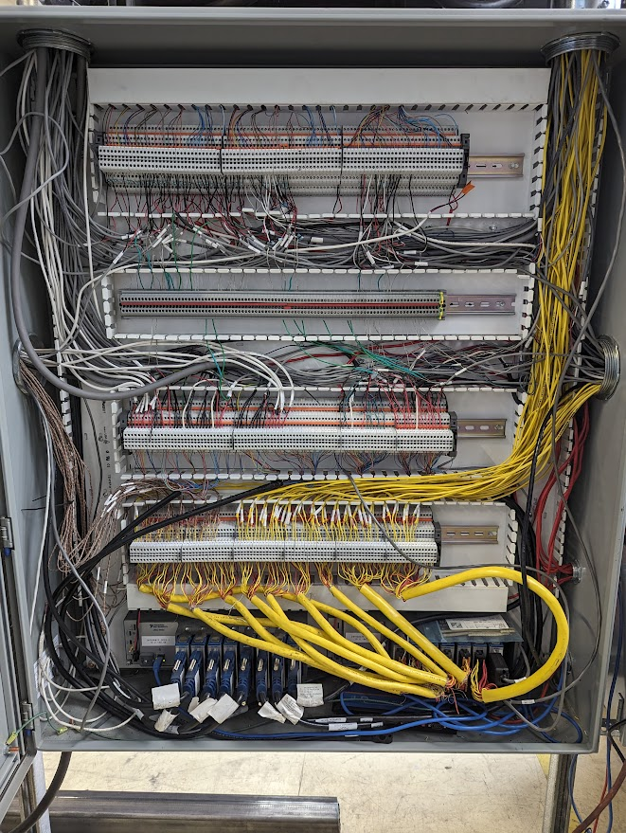
Shielded cable
Analog inputs
Shield grounding blocks
Analog and digital outputs
Notes:
Plan to give yourself a convenient grounding location when designing your DAQ cabinet. Also note there are no power supplies in here

Slide 14
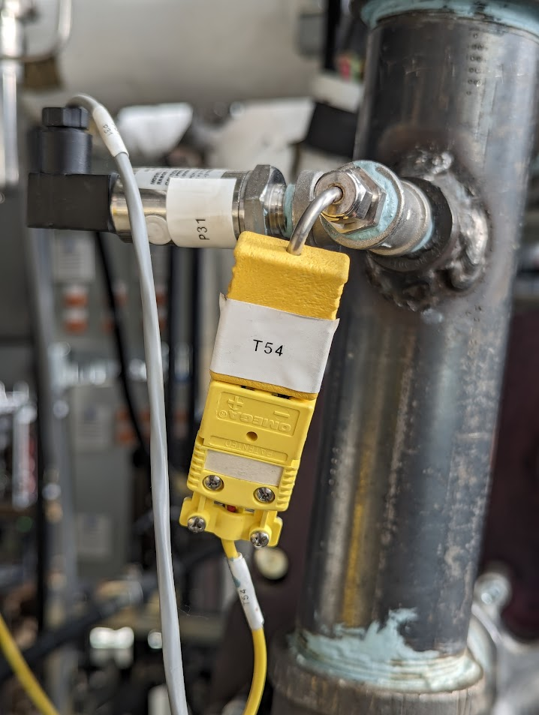
Labeling
Assign all instruments in the system a unique instrument number or name
Wires should be labeled with the instrument number on both ends

Slide 15
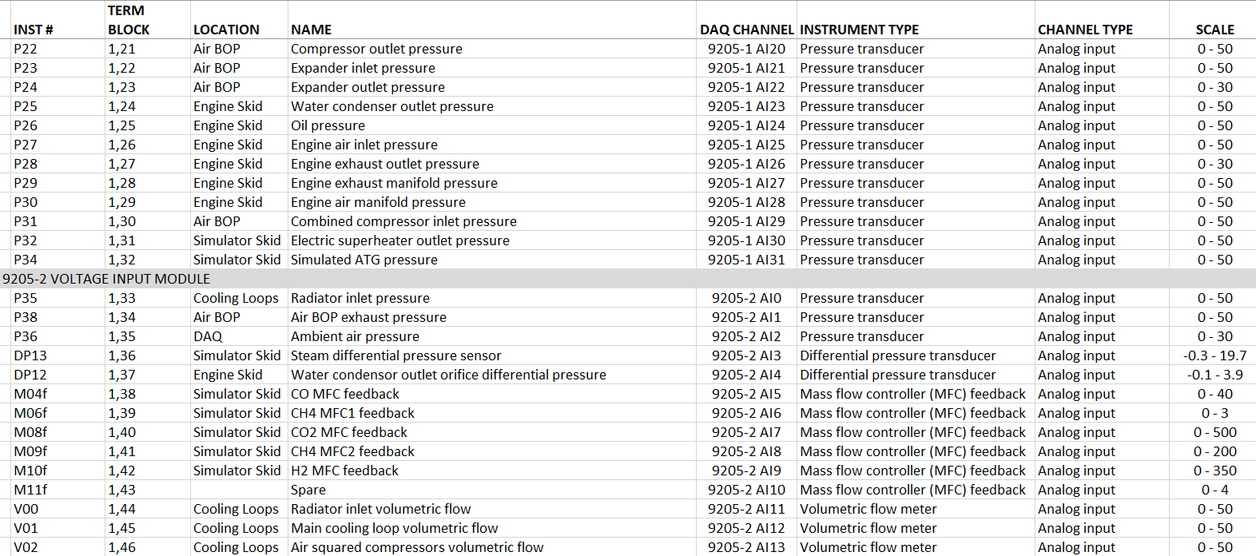
Instrument list
Maintain a good list of all instruments in your system, what channel they are connected to, scale factors, etc.

Slide 16
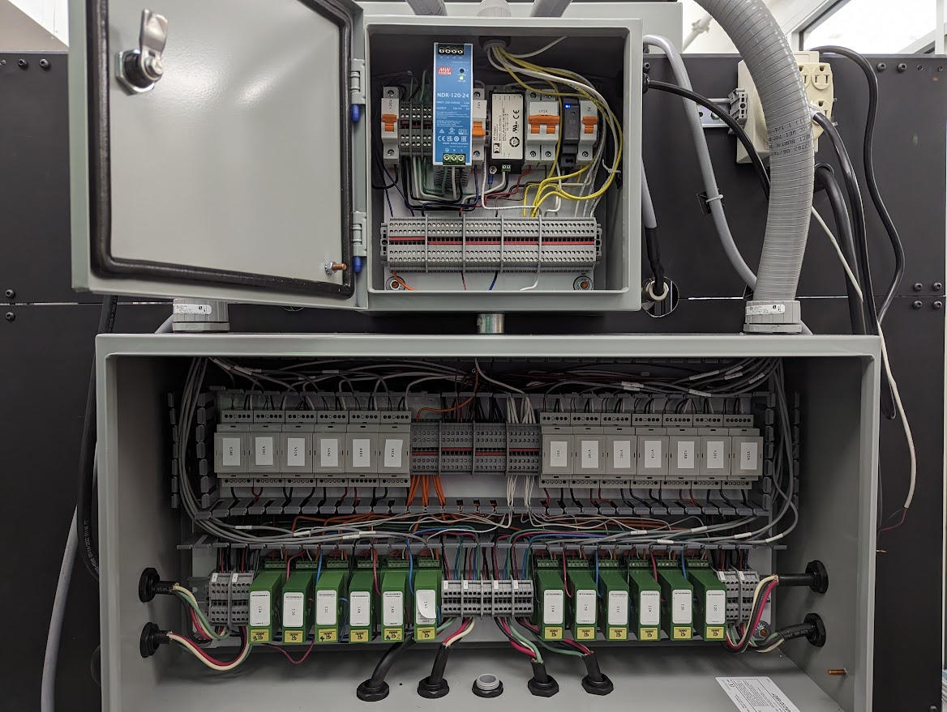
Cabinet design

Slide 17
Repository
All code can be found at: https://github.com/chris-lute/Powerhouse_research
Or email me at: chris.lute@colostate.edu

